Slide 1

Pictograms: Visual Data Storytelling
Welcome to our journey into the world of pictograms! Today, we'll discover how pictures can tell powerful data stories that are easy to understand at a glance.

Slide 2
What We'll Learn Today
1
What is a pictogram?
2
Key components
Understanding the definition and purpose of pictograms
Learning the essential parts that make up an effective pictogram
3
Real-world examples
4
Creating our own
Discovering pictograms in our everyday lives
Designing and interpreting pictograms with our class data

Slide 3
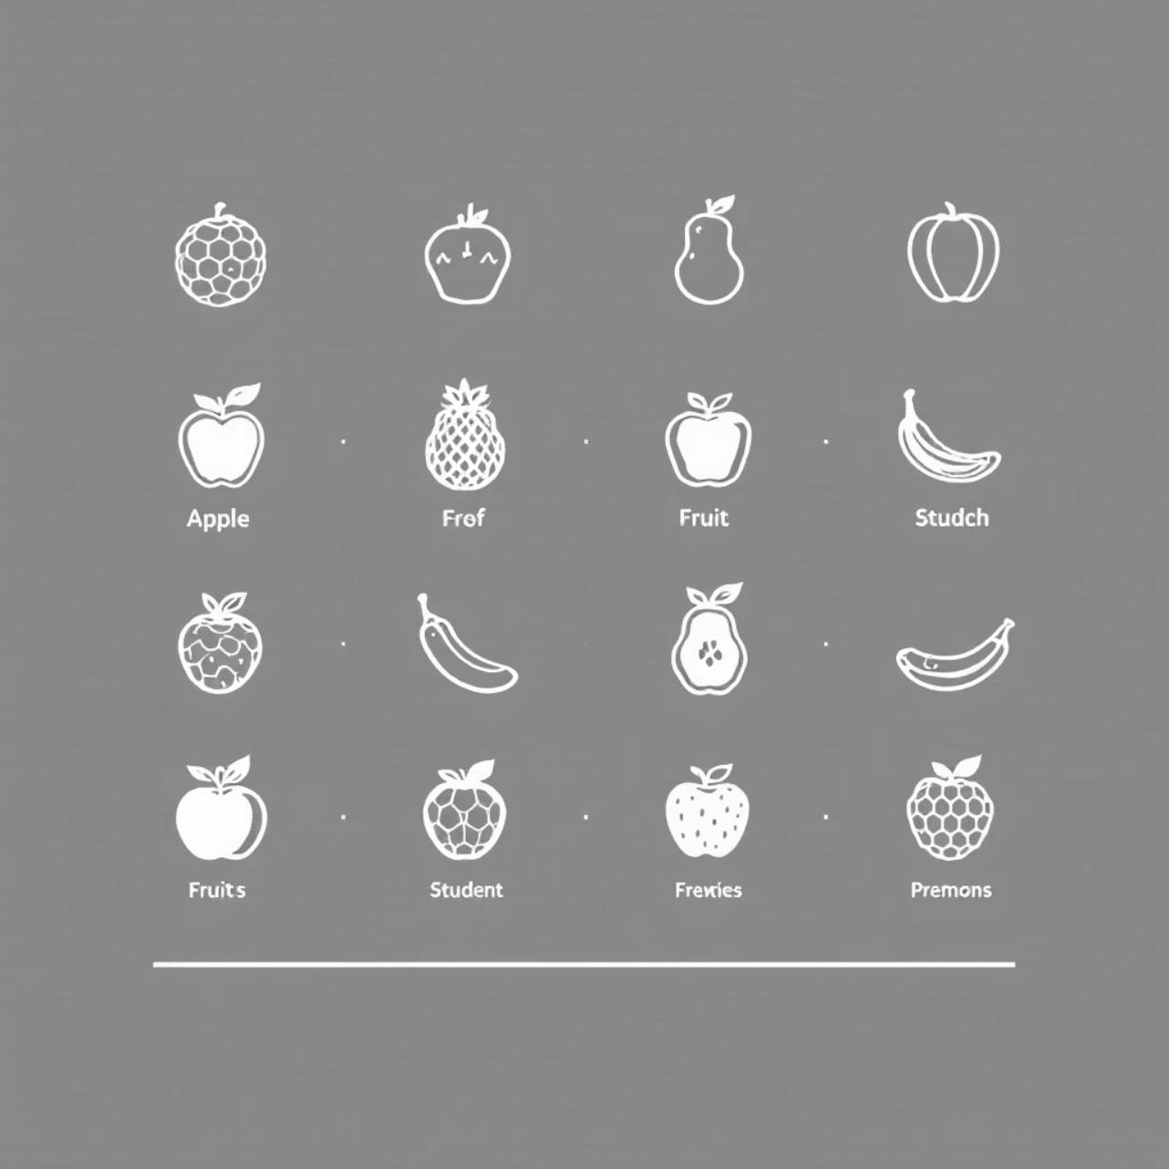
What Is a Pictogram?
A pictogram is a chart that uses pictures or symbols to represent data instead of just numbers.
Pictograms make information:
Easy to understand at a glance
Visually engaging and interesting
Accessible to everyone, even if they're not strong readers
More memorable than tables of numbers

Slide 4





Essential Components of a Pictogram
Title
Symbols
Tells us what the pictogram is about (e.g., "Our Favorite Sports")
Simple icons that represent the data (e.g., ⚽ for soccer)
Key
Labels
Explains what each picture is worth (e.g., ⚽ = 2 students)
Names for each category (Soccer, Swimming, etc.)

Slide 5

Pictograms in Our Daily Life
We see pictograms everywhere, even if we don't realize it!
Road signs (No Parking, No Entry)
Restroom symbols for men and women
Weather symbols on forecasts
Safety instructions on airplanes
App icons on your tablet
These all use simple pictures to communicate important information quickly and clearly.

Slide 6
Reading a Pictogram
Step 1: Read the title
Step 2: Check the key
Understand what information the pictogram is showing
See how many items each symbol represents (e.g., 🍎 = 5 students)
Step 3: Count the symbols
Step 4: Compare the data
Calculate the total for each category by multiplying
Look for patterns, highest/lowest values, and differences
Let's practice with an example on the next slide!

Slide 7


Practice: Class Favorite Book Genres
Look at this pictogram and answer:
What is the most popular book genre?
How many students prefer history books?
What is the total number of students surveyed?
How many more students prefer adventure books than history books?
Remember: Count the icons and multiply by the key value!

Slide 8

Let's Create Our Own Pictogram!
Here's our data about favorite colors in our class:
Red: 8 students
Blue: 12 students
Green: 6 students
To create our pictogram:
Choose a symbol (e.g., ❤️ for all colors)
Decide what each symbol represents (e.g., ❤️ = 2 students)
Calculate how many symbols to draw for each color
Add a title, labels, and key

Slide 9
Pictograms vs. Tables
Pictograms
Tables
Visual and engaging
More precise with exact numbers
Easy to understand at a glance
Can show more detailed information
Good for comparing amounts
Good for recording raw data
Perfect for presenting to others
Easier to show very large numbers
Makes data more memorable
Takes longer to understand
Both have their uses! The best choice depends on your purpose and audience.

Slide 10


What We've Learned
Pictograms use symbols to show data
Quick Check:
They make information visual and easy to understand
If the key of a pictogram is 🍎 = 4 students, how many students does 🍎🍎🍎 represent?
Every pictogram needs 4 key parts
Think about it... then raise your hand to answer!
Title, symbols, key, and labels
Next class: We'll learn about bar graphs and how they compare to pictograms!
We see pictograms everywhere
From road signs to weather forecasts
Creating pictograms is fun and useful
A skill you'll use in many subjects and real life!

